Slide 1
Hotel management application
Submitted by
RITWIK YADAV

Slide 2
agenda
Project Abstract
Problem Statement
Modules
Customer Module Design
Employee Module Design
Admin Module Design
Project Flow
Software Requirements
Reference

Slide 3
Project abstract
This project reflect developing a Hotel Management Application
This helps to locate rooms on hotels and to grant stay at rooms
This is an integrated system which contains customer , employee and admin modules
There are features to view the booking details and payment details
This helps to modify their details and stay

Slide 4
Problem statement
To provide simple working which help to retrieve information
To decrease hard work which uses paper work and to ease human effort
To maintain authenticity and authorized way of booking hotels
To provide accurate data which is required

Slide 5
modules
There are 3 modules present in the application
Customer : Customer can easily book hotels based on their requirements and to have a track among them
Employee : Employee can provide facilities to customer and their requirement during their stay
Admin : Admin can create,update or modify changes on the stay,rooms,billing,staff based on their requirement

Slide 6
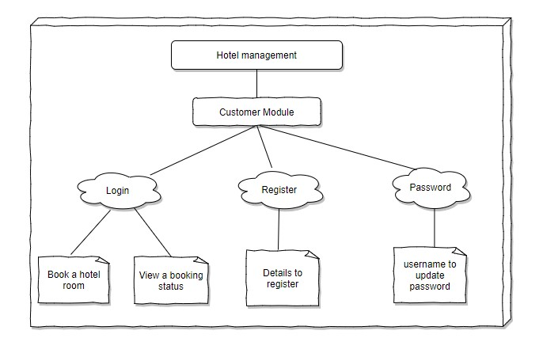
Customer module design

Slide 7
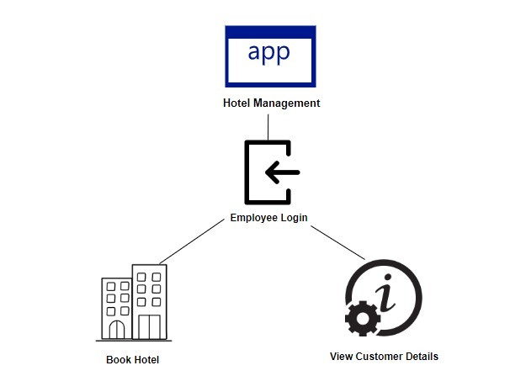
Employee module design

Slide 8
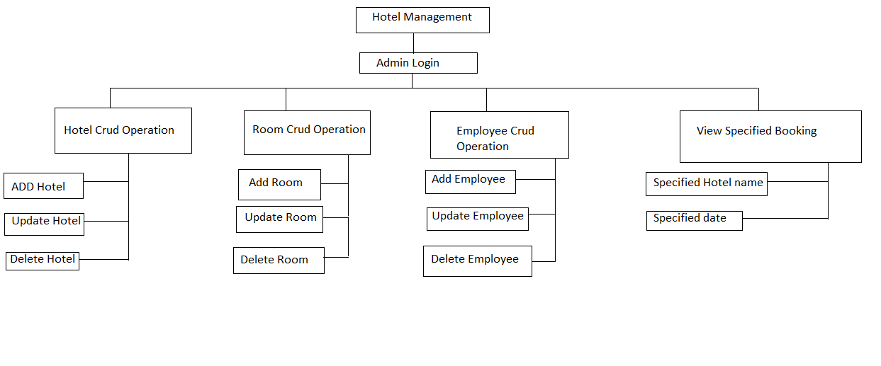
Admin module design

Slide 9
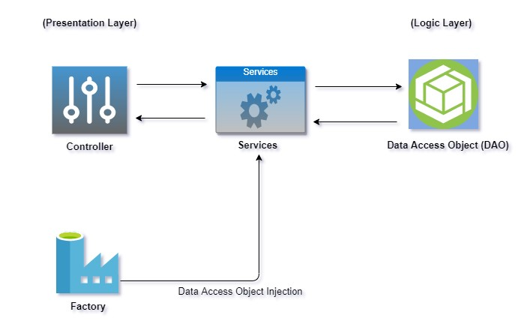
Project flow

Slide 10
Software Requirements
Eclipse :-source code editor for java programming

Slide 11
references
www.stackoverflow.com
www.youtube.com
www.w3schools.com
http://www.tutorialspoint.com

Slide 12
Thank you

